Slide 1
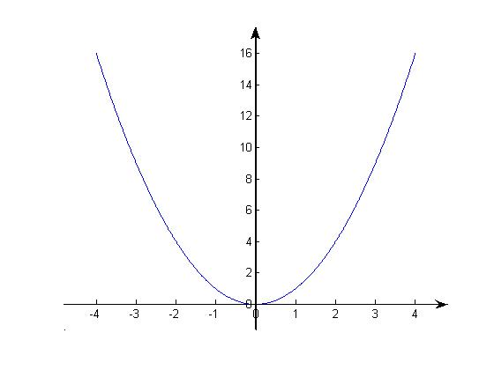
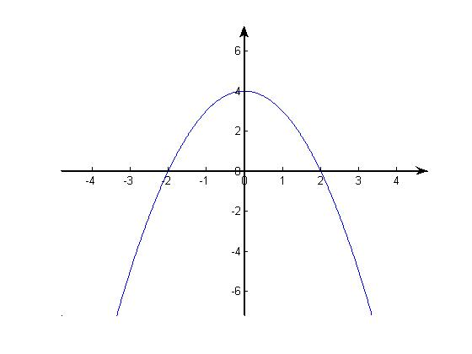
Section 4.4 Concavity and curve sketching
Let us first look at two graphs

Slide 2
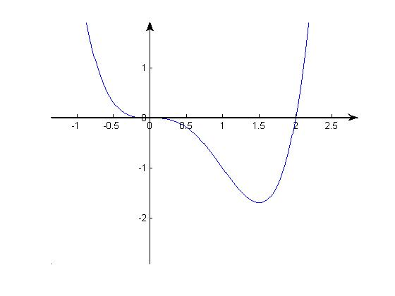
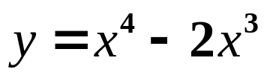
The graph of

Slide 3
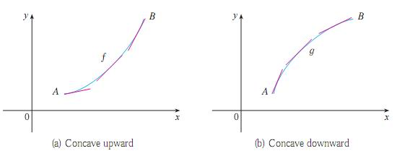

Slide 4



Slide 5

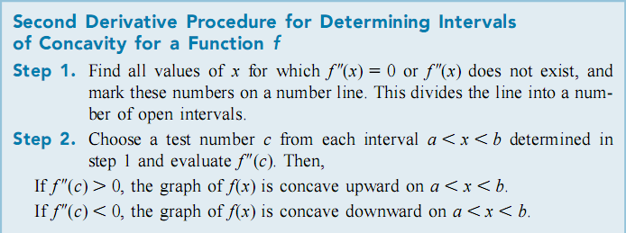

Slide 6

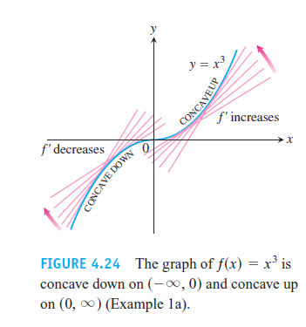
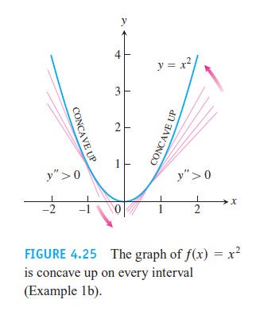

Slide 7
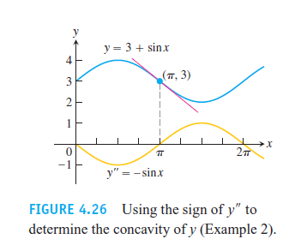

Slide 8

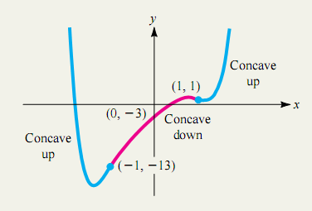
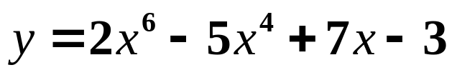
The graph of

Slide 9


Slide 10

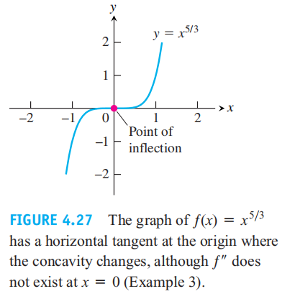

Slide 11

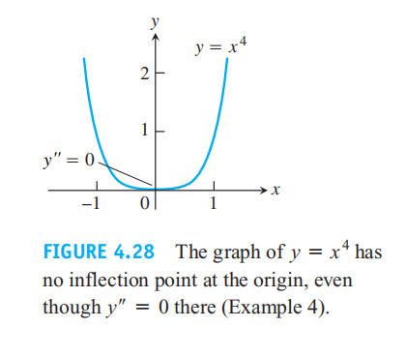

Slide 12

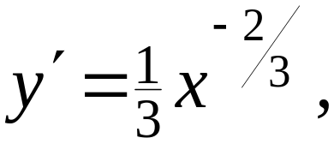
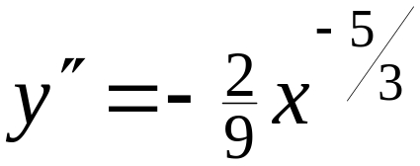











Example 5. Find the inflection points of
Solution:
ND
CU
CD
Therefore, ( 0 , 0 ) is an inflection point of the graph of

Slide 13
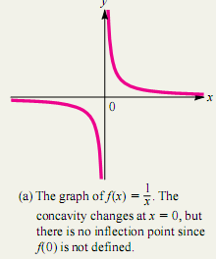
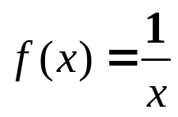
Remarks:
A function can have an inflection point only where it is
continuous. In particular, if f(c) is not defined, there can
not be an inflection point corresponding to x=c even if f’’(x)
changes sign at x=c. For example,

Slide 14


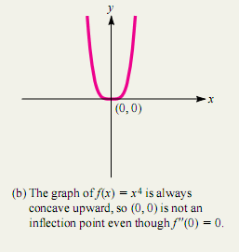
(2) Even though f(c) is defined and that f’’(c)=0 does not
guarantee that (c, f(c)) is an infection point. For instance,

Slide 15

Now we apply the second derivative to local extrema, and obtain the following test:
Theorem: (Second Derivative Test for Local Extrema)

Slide 16
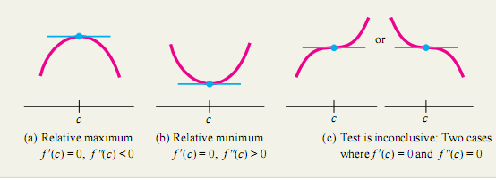



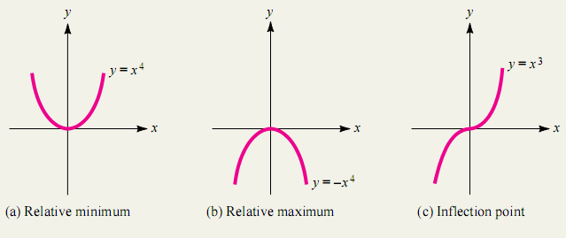
To illustrate case (c), you can consider the functions:

Slide 17
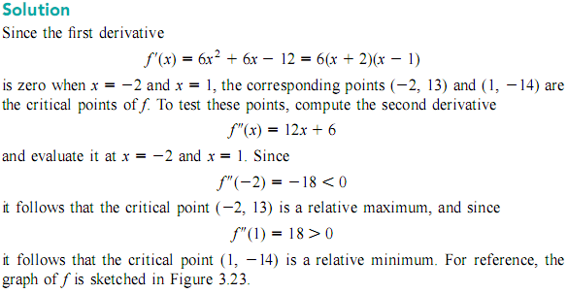
Example 6.

Slide 18
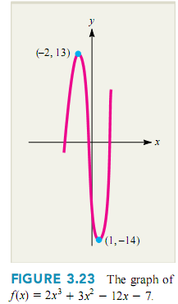

Slide 19




There are four basic shapes:
(1) Increasing and concave upward
(2) Increasing and concave downward
(3) Decreasing and concave upward
(4) Decreasing and concave downward

Slide 20
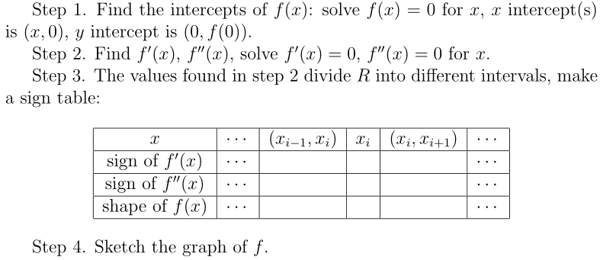

Slide 21



Slide 23
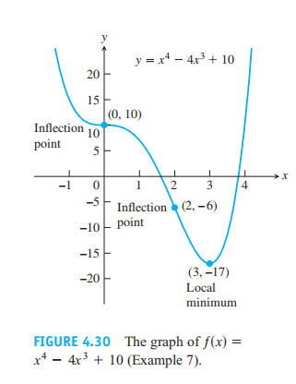

Slide 24

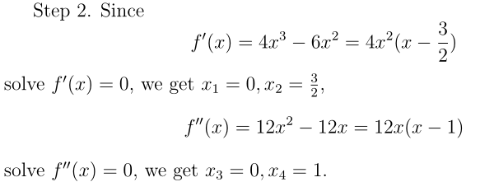

Example 8.

Slide 25


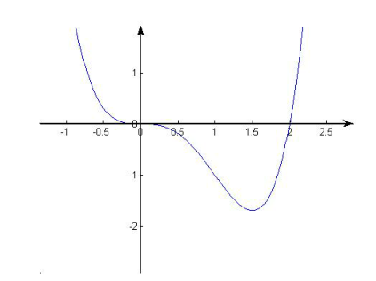

Slide 26
Homework: P252 20, 90

